Slide 1
TEXT AS DATA IN R
Jesse Lecy
Arizona State University

Slide 2
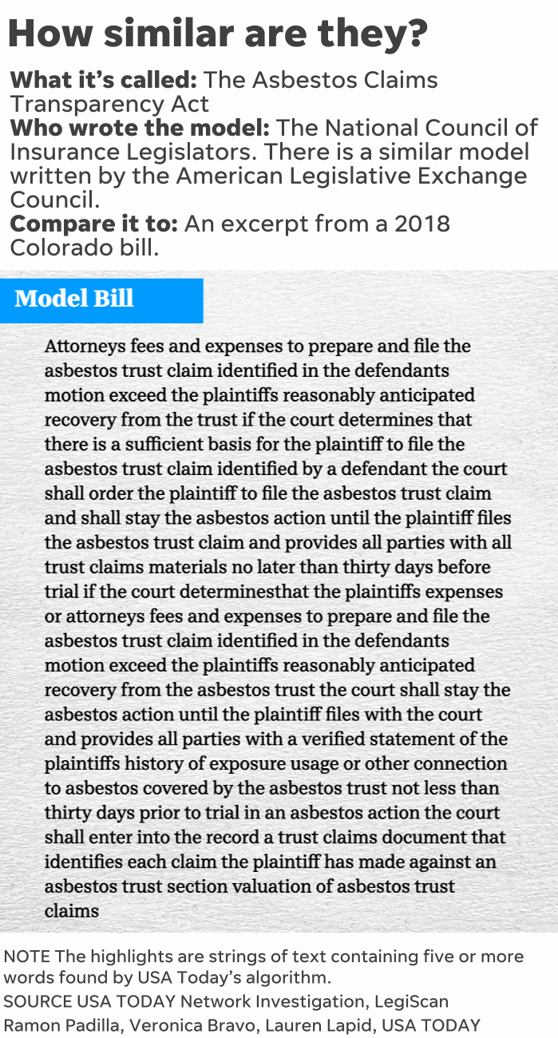
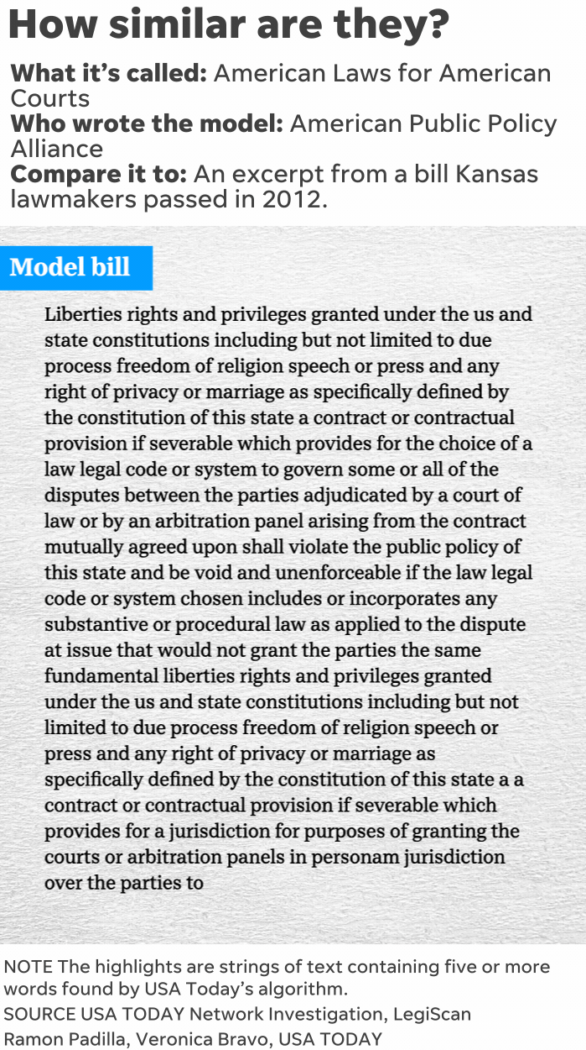
You elected them to write new laws. They’re letting corporations do it instead.

Slide 3
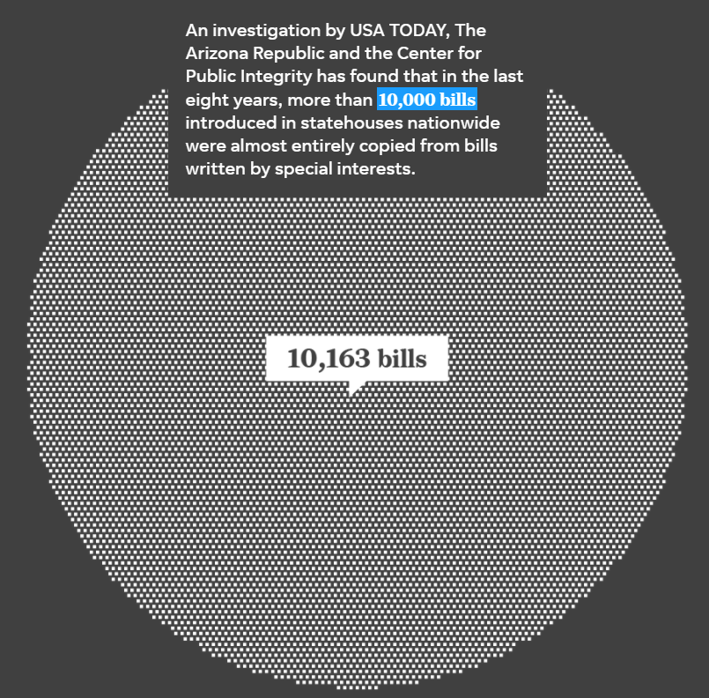
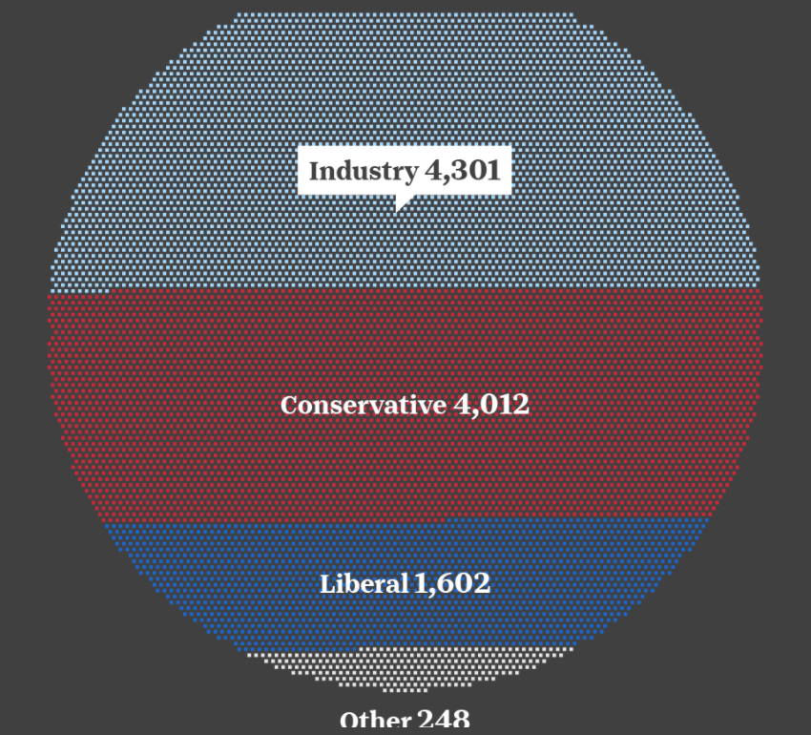

Slide 4
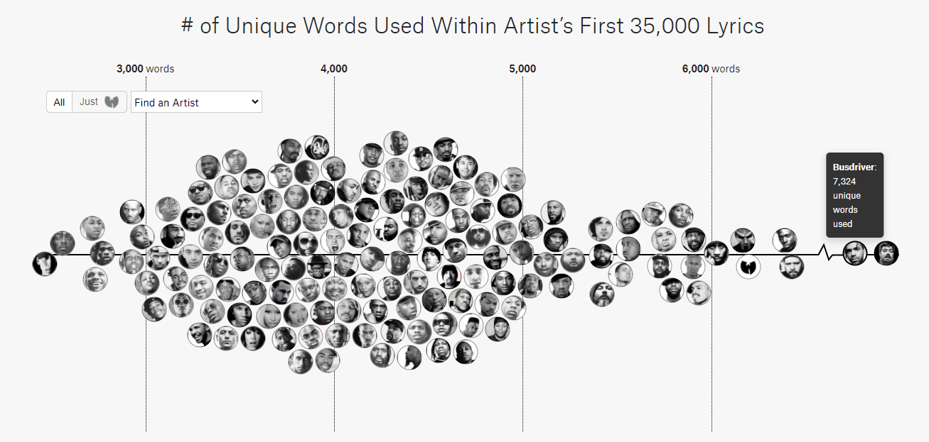
The Largest Vocabulary In Hip Hop

Slide 5
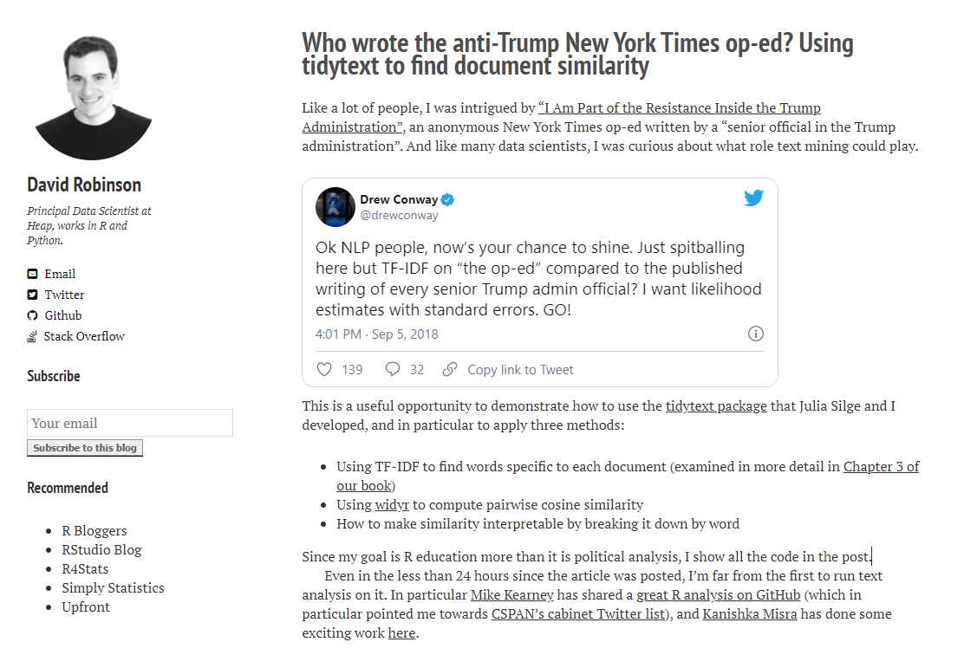

Slide 6
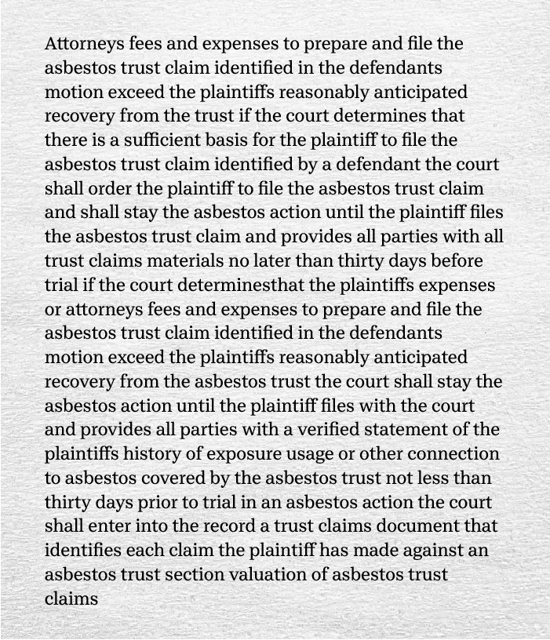
text as data
raw text
Step 1 – Get Some Text

Slide 7
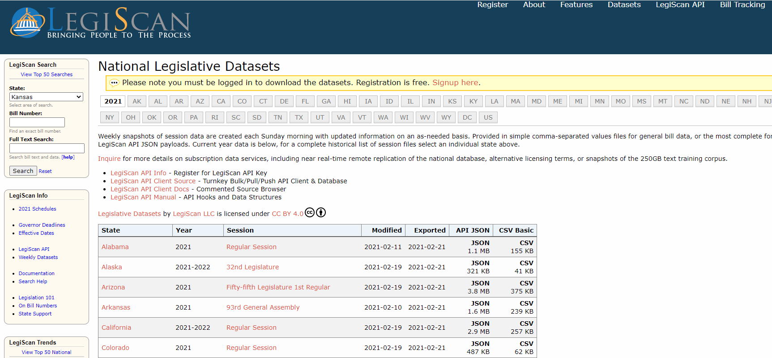

Slide 8
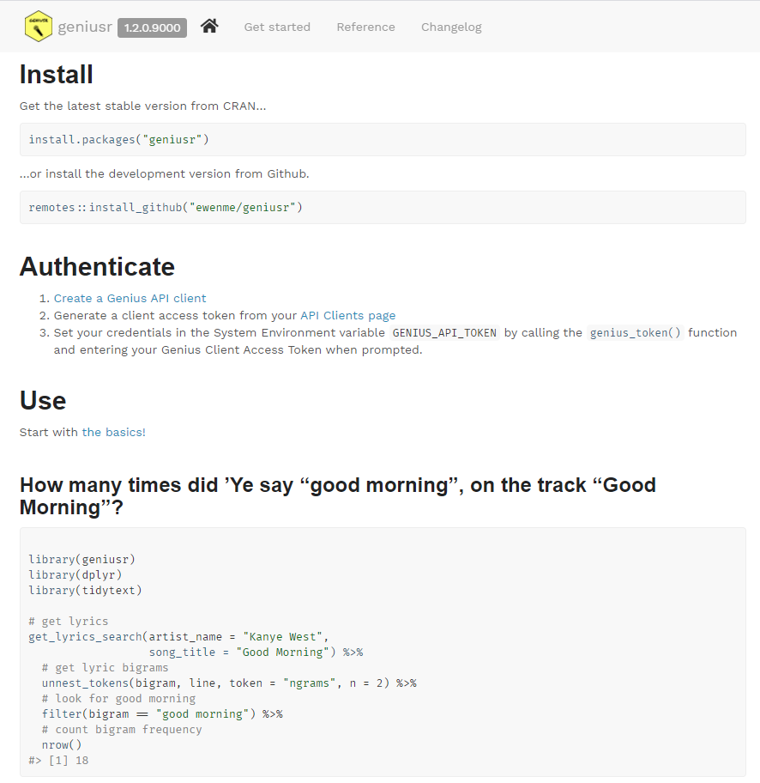
R Package geniusr: API for Genius platform
Genius celebrates More Than The Music—the lyrics, the stories behind the songs, and the creative connections that meaningfully drive culture. We champion curiosity and believe that everyone has music knowledge to share: insights, intel, and musings that make us more informed, engaged music lovers. As the world's biggest music encyclopedia with a passionate community of more than two million contributors, Genius is a destination for artists, creatives, and superfans to discuss and deconstruct all things music. Through our original content, technology, and live & virtual experiences, Genius spotlights the artists who are shaping music culture across every genre and musical discipline, sharing the stories behind their creativity and craft in their own words.

Slide 9
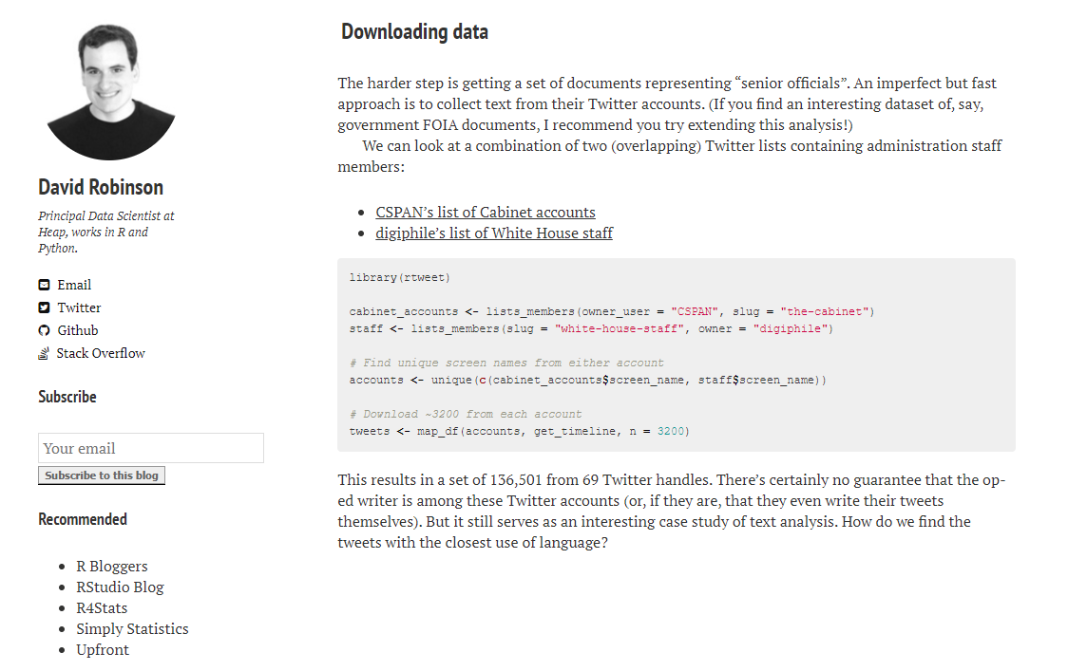
“This results in a set of 136,501 tweets from 69 Twitter handles”

Slide 10
text as data
raw text
Step 2:
Standardize the data
pre-processing
Remove punctuation
Remove “stop” words
Identify compound constructs
Stem words

Slide 11
Unit of Analysis: Nonprofit Mission Statements
The corporation’s specific purpose is to supports affordable housing, community development and economic development of the city and county of San Francisco’s economically disadvantaged individuals and communities, by lending to, investing in, and directly acquiring such affordable housing and related community development real estate assets.

Slide 12
the corporation specific purpose is to support affordable_housing, community development and economic_development of the city and county of san_francisco economically disadvantaged individuals and communities by lending to investing in and directly acquiring such affordable_housing and related community development real_estate assets
Remove punctuation
Delete words with little information value (“stop” words)
Identify compound constructs (n-grams)

Slide 13
Stemming
lend
lending
relate
related

Slide 14

DISAMBIGUATION
George W. Bush
George Bush Jr.
President Bush
GW_BUSH

Slide 15
DISAMBIGUATION
PLACE
New York City
New York University
New Yorker
New York
THING
STATE oF MIND
STATE

Slide 16

Step 3:
Wrangle the data
raw text
pre-processing
transformation
Word frequency table
Document Frequency Matrix
Co-occurrence Matrix
Word vector machines

Slide 17
Raw text
Tokenized text
To educate, train and assist in providing emergency medical service for the community.
"educ" "train" "assist" "provid" "emerg" "medic" "servic" "communiti"
Semantic Networks
provid
communiti
educ
medic
emerg
train
servic
assist

Slide 18
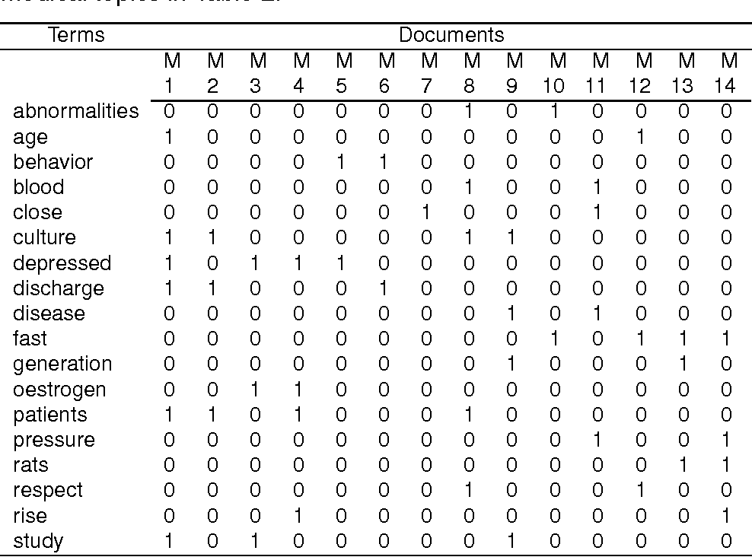
Document Frequency Matrix (DFM)

Slide 19
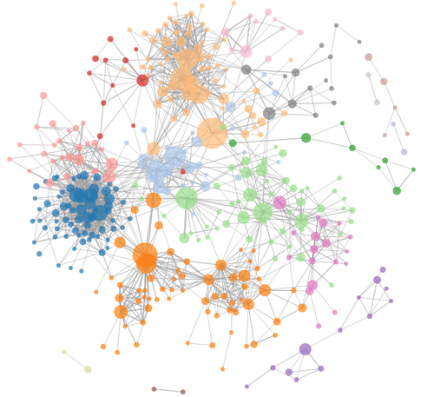
text as data
raw text
analyze
pre-process
transform
Content analysis
Sentiment analysis
Semantic network analysis
Bayesian classifiers

Slide 20
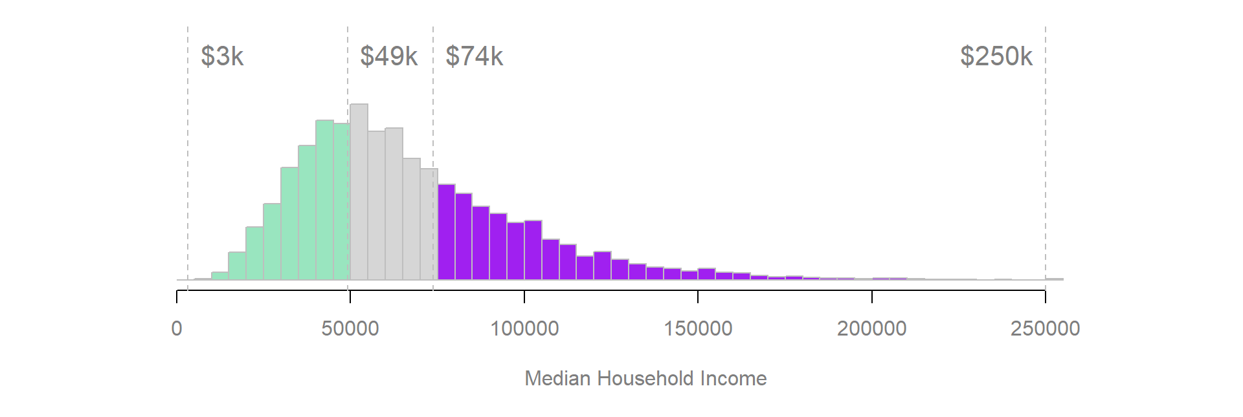
Board Influence on Mission:
HOLD CONSTANT nonprofit subsector and community income status
VARY the board traits of the nonprofit
LOW Average Board Income
HIGH Average Board Income
2,141
tracts
tracts
ARTS nonprofits located in low-income communities

Slide 21
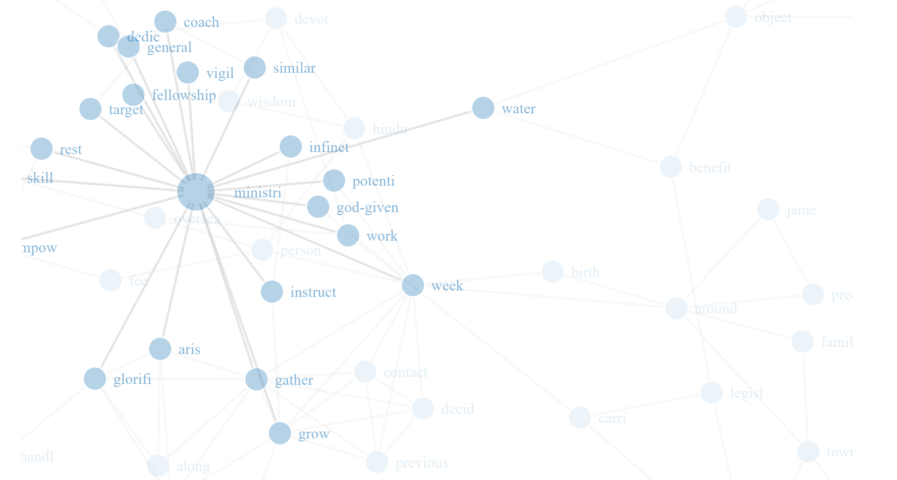
If board members matter, similar orgs with distinctive boards should have different missions
Male vs Female Boards
Regular vs wealthy boards
Racially diverse vs homogenous boards

Slide 22
Mission
Statement 1
Union (all statements) and Intersection
Mission
Statement 2
D
D
A
B
B
A
B
C
C
C
H
H
E
F
G
E
E
F
G

Slide 23
Analyzing Missions by Types of Nonprofits
Mission Statement Components Unique to Org 1:
A-B
A-C
B-D
D
H-E
G-E
E-F
Mission Statement Components Unique to Org 2
A
B
C
H
E
F
G
Doesn’t work well with dense weighted graphs!

Slide 24
Data structure of a weighted network:
Freq ALL | Freq GROUP | Term 1 | Term 2
10 | 7 | econ | dev
7 | 4 | self | reliance
5 | 3 | dev | con
5 | 2 | globla | econ
4 | 2 | local | econ
4 | 1 | soc | econ
3 | 2 | econ | socialism
3 | 3 | finance | global
3 | 2 | global | finance
3 | 2 | global | impsm
3 | 1 | impsm | global
3 | 1 | impsm | invasion
Is it significant that economic development was mentioned 7 times by a specific type of organization?

Slide 25
ALL MISSION STATEMENTS
SUB-GROUP
D
A
B
B
C
C
H
H
DEV
F
DEV
F
ECON
ECON
n=7
N=10
How often will a random sample of dyads from the full weighted network produce the observed number of “statements” (semantic network ties) in a group?

Slide 26
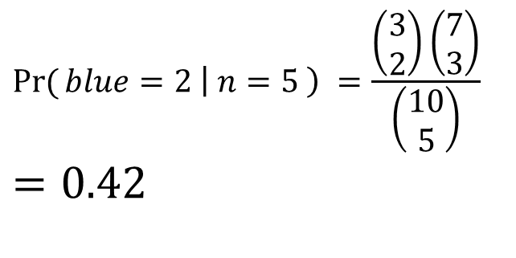
D
Is it significant that G-E occurs 2 times in the sample?
What is the probability of selecting 2 blue balls from a sample of 5 balls?
A
B
C
H
E
F
G
X=3, N=10
$$\operatorname{Pr}{(}blue=2 \left| n=5 \right) =\frac{\left(\begin{matrix}3 \\ 2\end{matrix}\right)\left(\begin{aligned}7 \\ 3\end{aligned}\right)}{\left(\begin{matrix}10 \\ 5\end{matrix}\right)} \\ =0.42$$
B
C
H
E
F
G
x=2, k=5

Slide 27
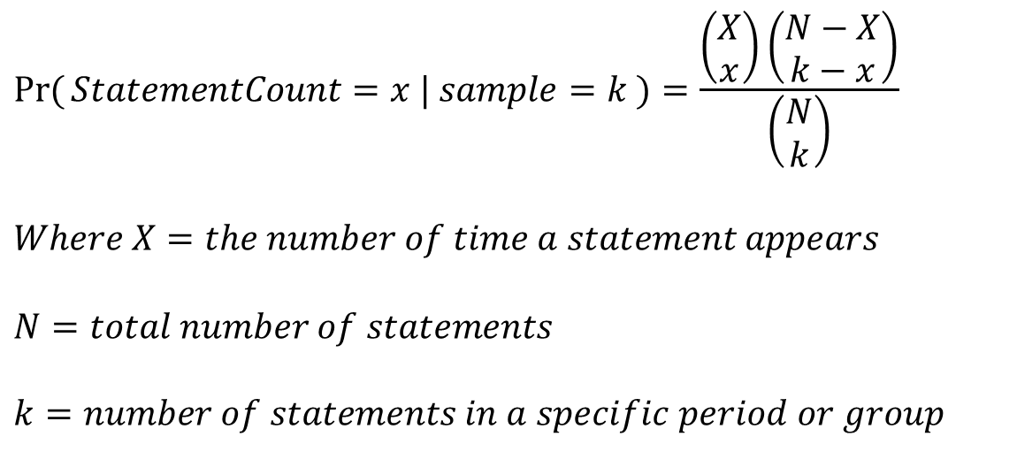
Generalized:
D
A
B
C
$$\operatorname{Pr}{(}StatementCount=x | sample=k )=\frac{\left(\begin{matrix}X \\ x\end{matrix}\right)\left(\begin{matrix}N−X \\ k−x\end{matrix}\right)}{\left(\begin{matrix}N \\ k\end{matrix}\right)}$$ $$Where X=the number of time a statement appears$$ $$N=total number of statements$$ $$k=number of statements in a specific period or group$$
H
E
F
G
X=3, N=10
B
C
H
E
F
G
x=2, k=5

Slide 28
Mission
Statement 1
Mission
Statement 2
Distinct Statements
D
D
A
B
B
A
B
C
C
C
H
H
E
F
G
E
E
F
G
Noise reduction: unique “statements” that occur more often than would be predicted by chance

Slide 29
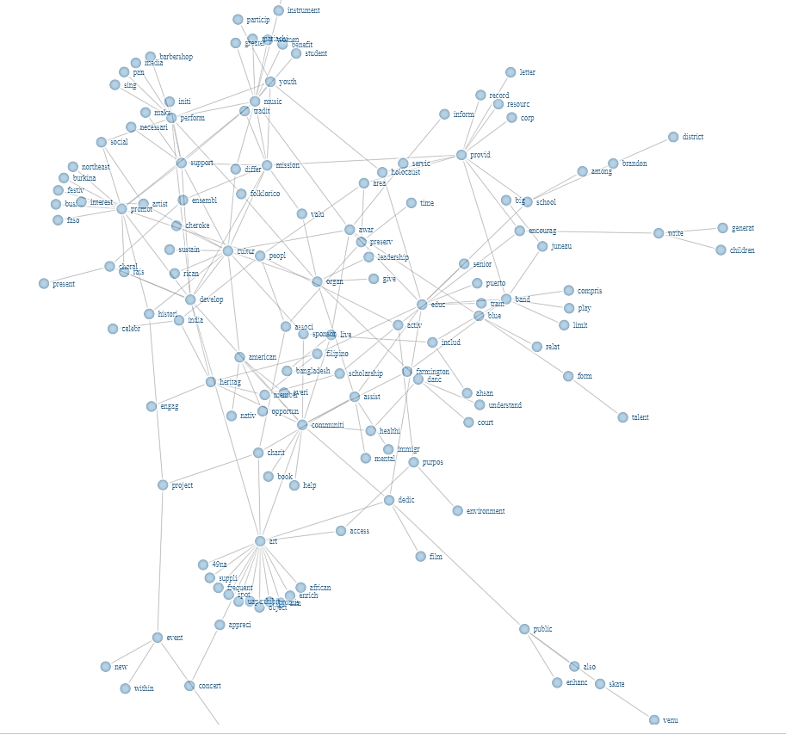
Only distinct edges retained those with observed frequencies that would occur less than 5% of the time by chance
Each Semantic Network Represents:
COMMUNITY: LOW INCOME
SUBSECTOR: HEALTHCARE
BOARD STATUS: LOW INCOME

Slide 30
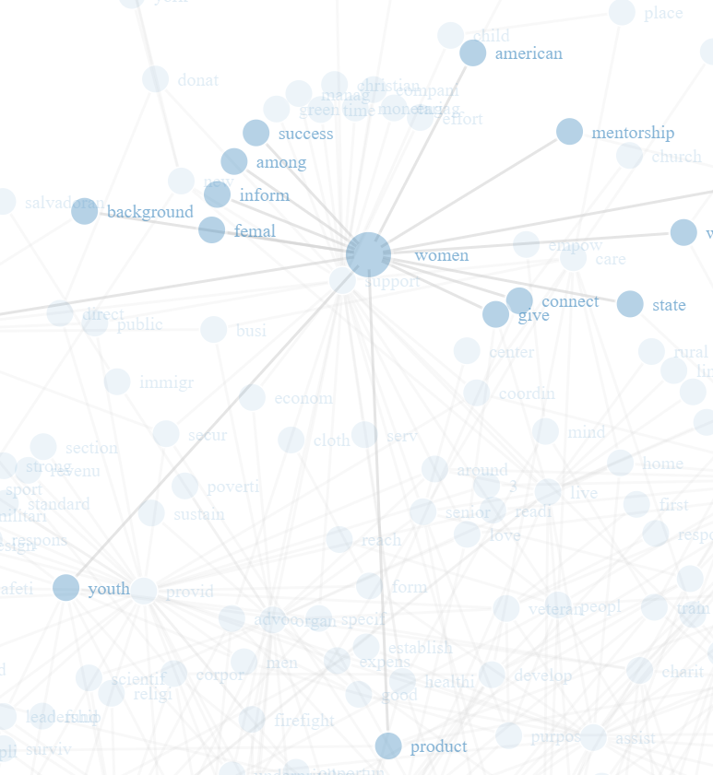
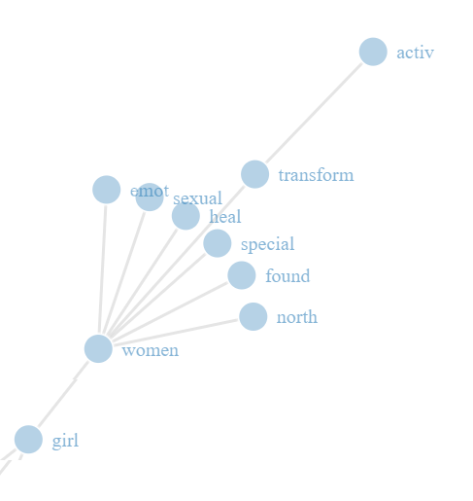
HIGH INCOME BOARDS
LOW INCOME BOARDS
HUMAN SERVICES: LOW INCOME NHOODS
HUMAN SERVICES: LOW INCOME NHOODS

Slide 31
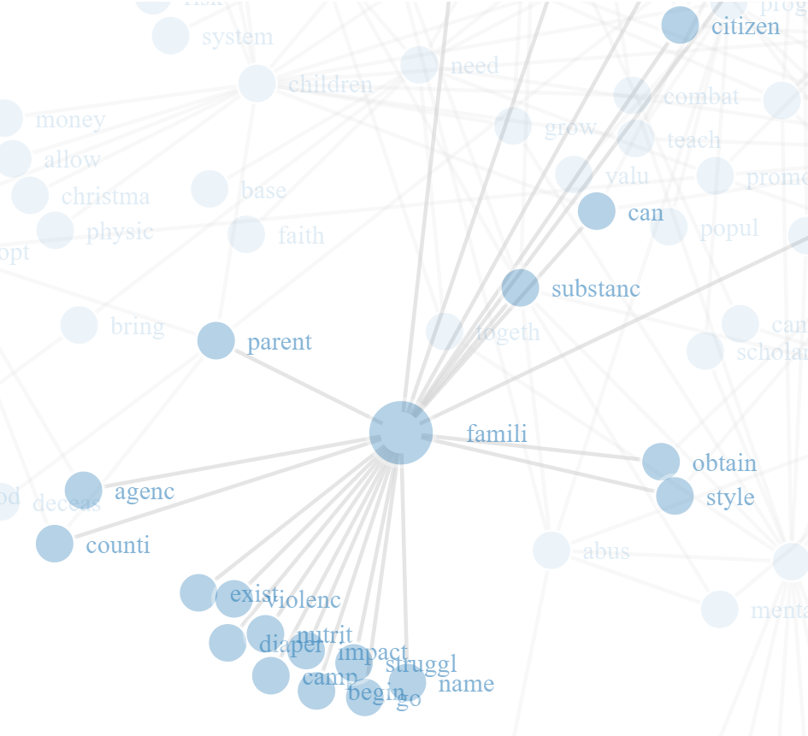
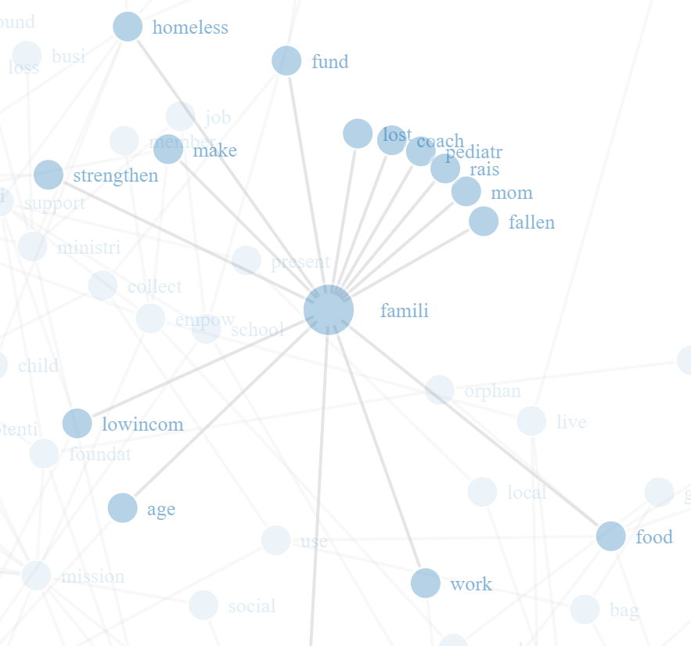
HIGH INCOME BOARDS
LOW INCOME BOARDS
HUMAN SERVICES: LOW INCOME NHOODS
HUMAN SERVICES: LOW INCOME NHOODS

Slide 32
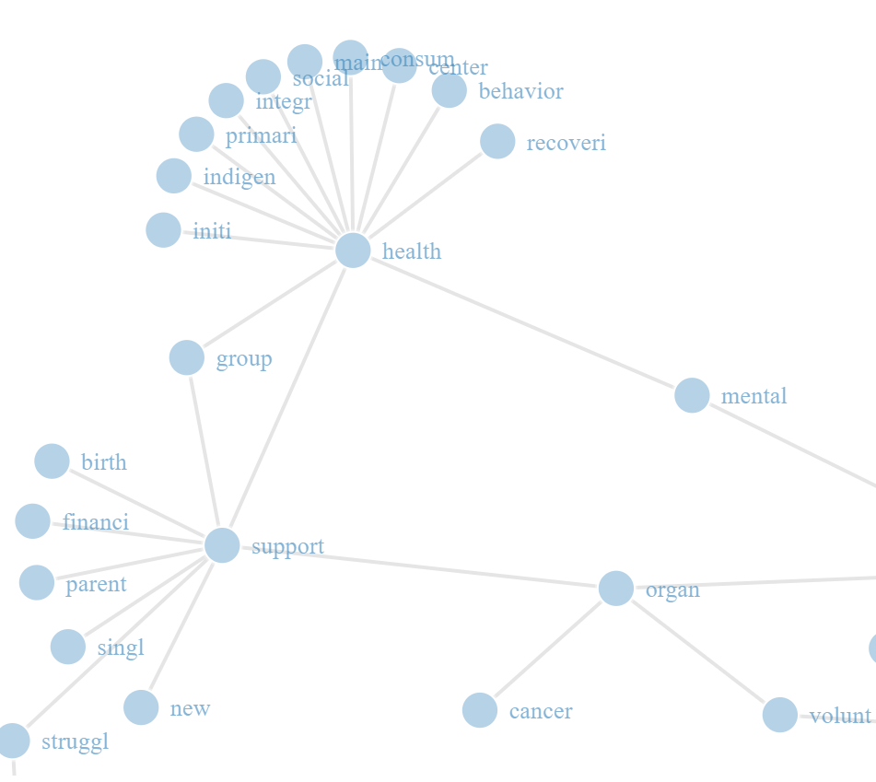
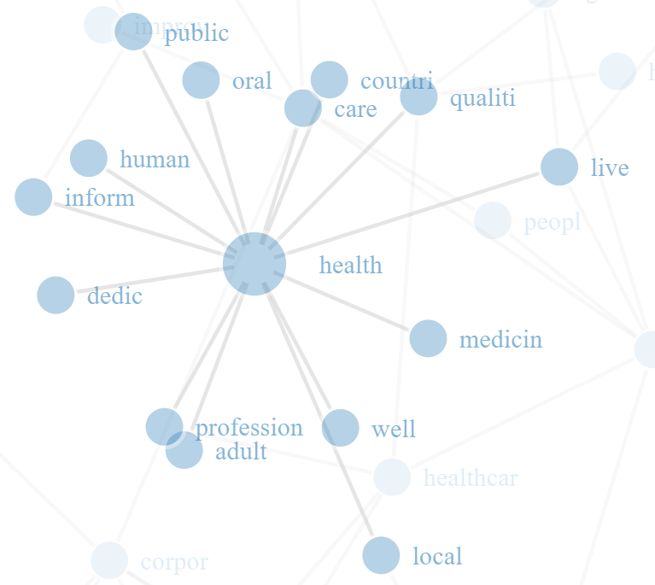
HIGH INCOME BOARDS
LOW INCOME BOARDS
HEALTHCARE: LOW INCOME NHOODS
HEALTHCARE: LOW INCOME NHOODS

Slide 33
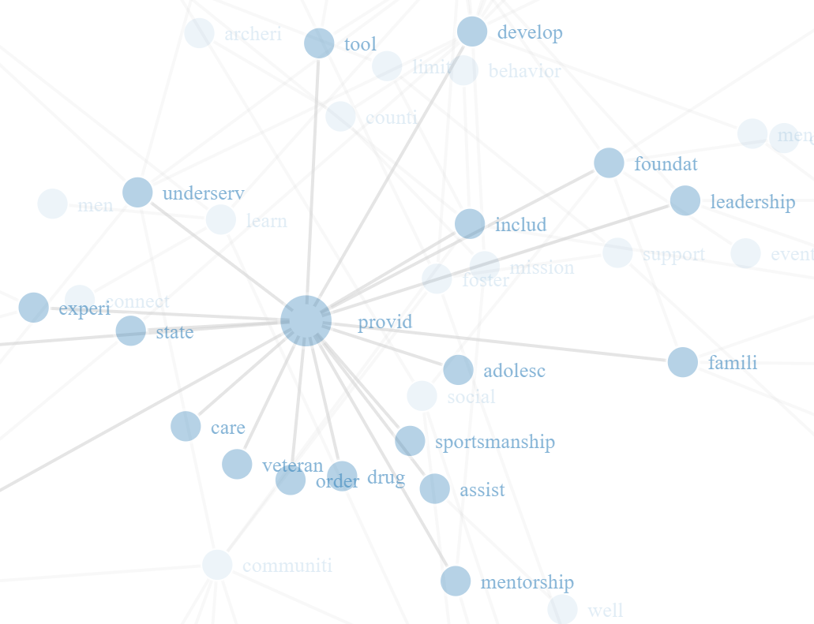
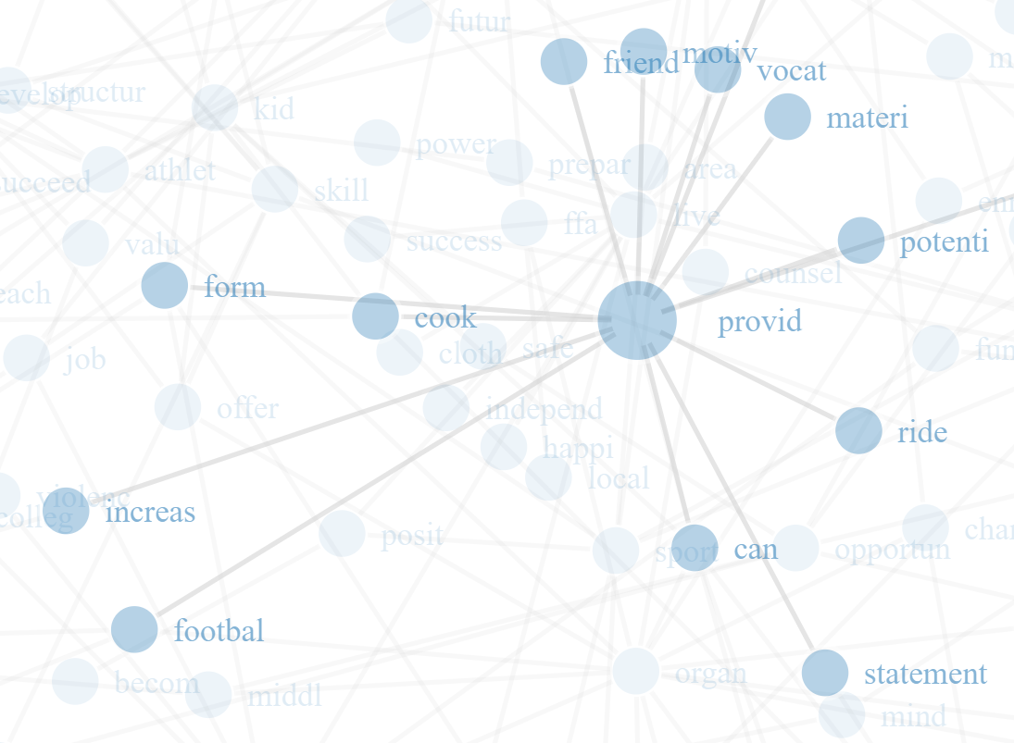
HIGH INCOME BOARDS
LOW INCOME BOARDS
YOUTH: LOW INCOME NHOOD
YOUTH: LOW INCOME NHOOD

Slide 34
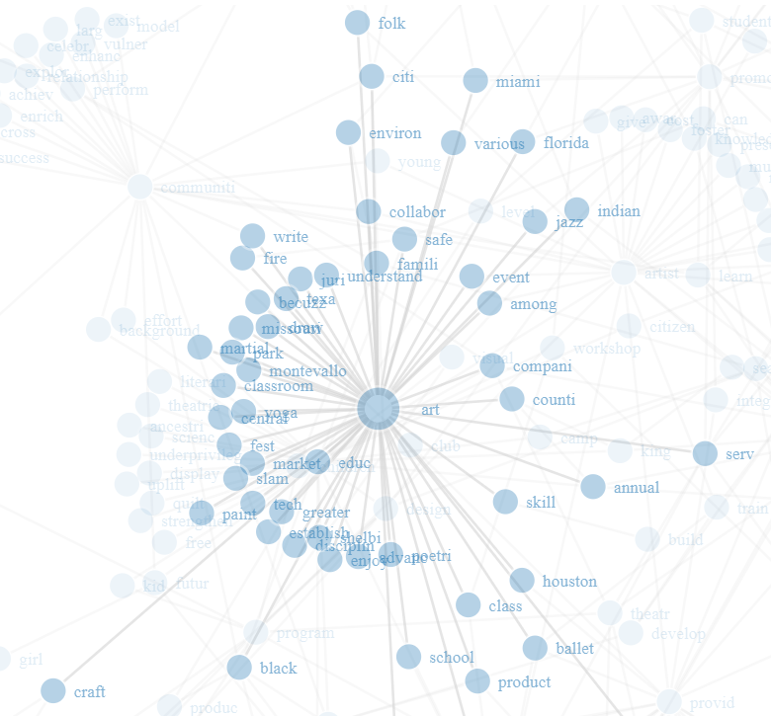
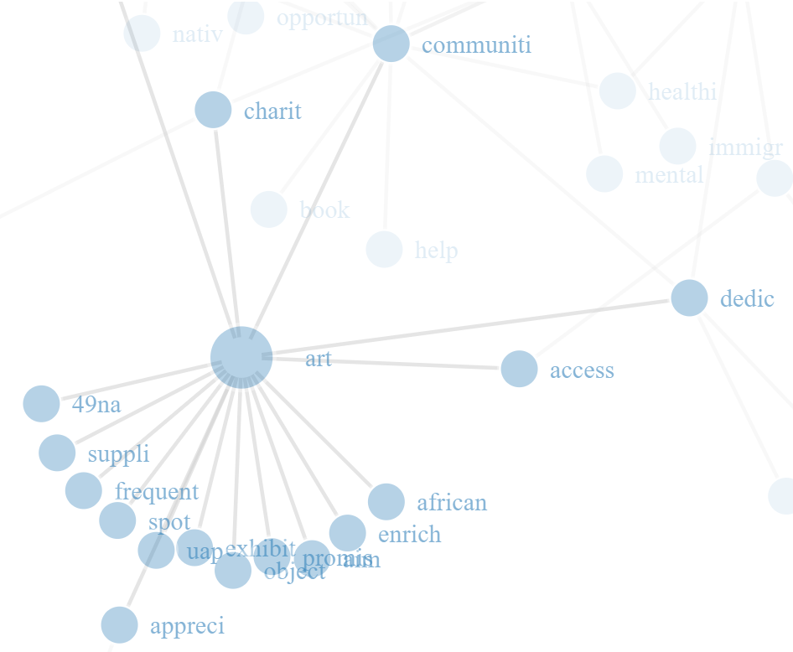
HIGH INCOME BOARDS
LOW INCOME BOARDS
ARTS: LOW INCOME NHOOD
ARTS: LOW INCOME NHOOD

Slide 35
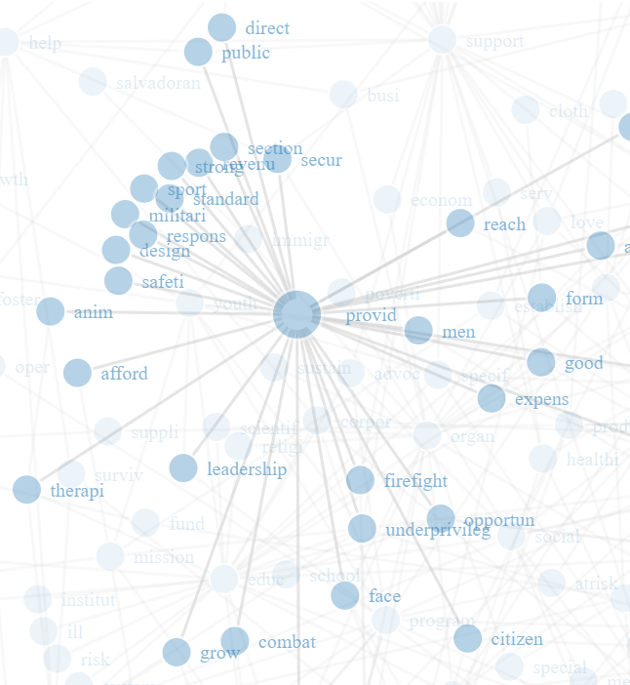
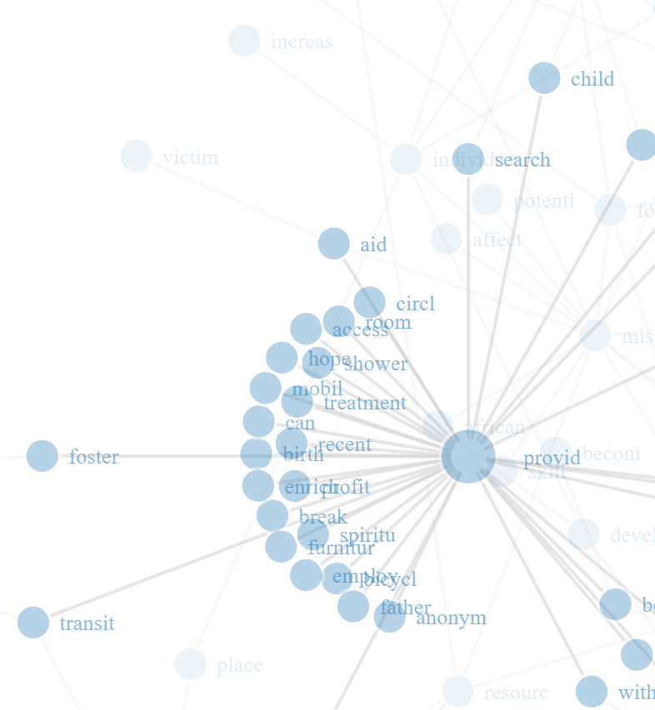
HIGH INCOME BOARDS
LOW INCOME BOARDS
HUMAN SERVICES: LOW INCOME NHOOD
HUMAN SERVICES: LOW INCOME NHOOD

Slide 36
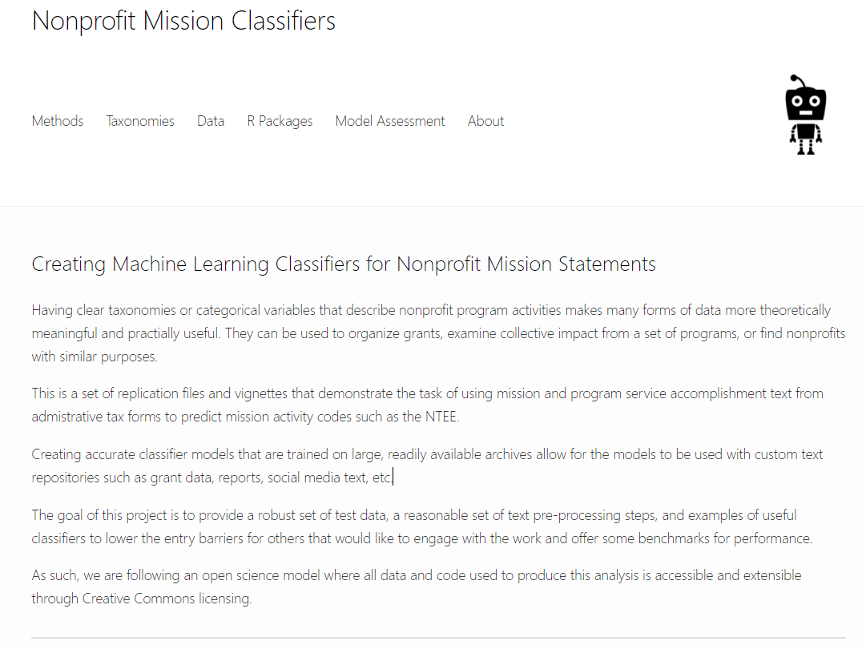


https://nonprofit-open-data-collective.github.io/machine_learning_mission_codes/

